Slide 1

Hybrid Quantum Neural Networks: Efficiency, Viability, and the Path Forward
SOTF Presentation
Andrew Nerud
CSCI 373

Slide 2

Why Hybrid Quantum Neural Networks (HQNNs)?
AI demands smaller, faster, more efficient models
HQNNs combine classical and quantum
Generalization, efficiency, and data processing
Overcome limitations of today’s AI
Are HQNNs ready for real-world adoption?

Slide 3
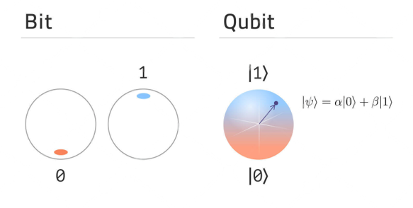
How HQNNs Work: Background
Quantum Computing Uses:
Qubits
Entanglement
Quantum Gates
Variational Quantum Circuits (VQCs)

Slide 4
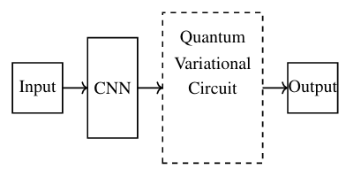
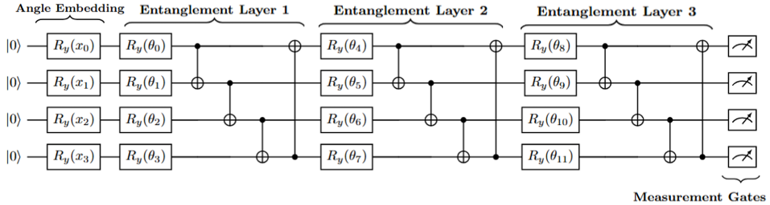
How HQNNs Work: Structure
Combines classical and quantum layers
Enables efficient feature extraction
Well-suited for high-dimensional, small-data tasks

Slide 5
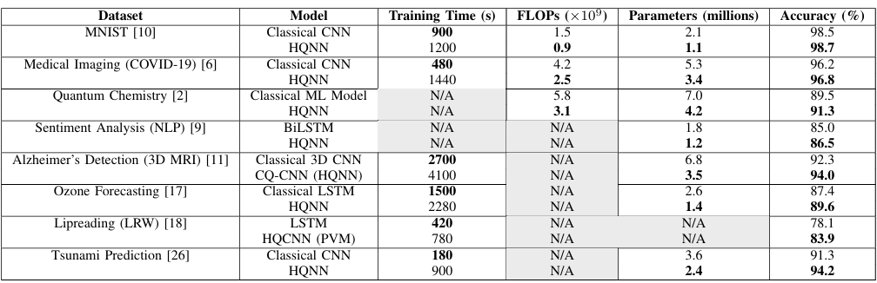
Current Research Advantages
(Better Performance per Category is Bolded)
HQNNs vs classical models
Up to 50% fewer trainable parameters
30% lower FLOPs
Smaller computation cost
Competitive accuracy
On medical and scientific datasets

Slide 6
Persistent Challenges in HQNN Adoption
Longer training times
Quantum noise and decoherence
Hardware Limitations
Lack of standardized benchmarks

Slide 7
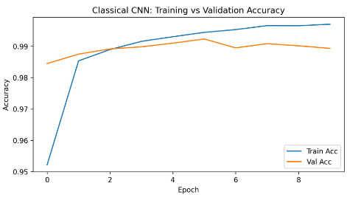
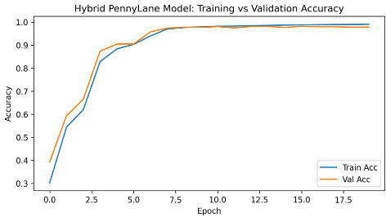
Experimental Results: HQNN for Digit Classification
HQNN achieved:
~98% accuracy
88% fewer parameters
63% fewer FLOPs
Significantly slower training time
Limits Practicality

Slide 8
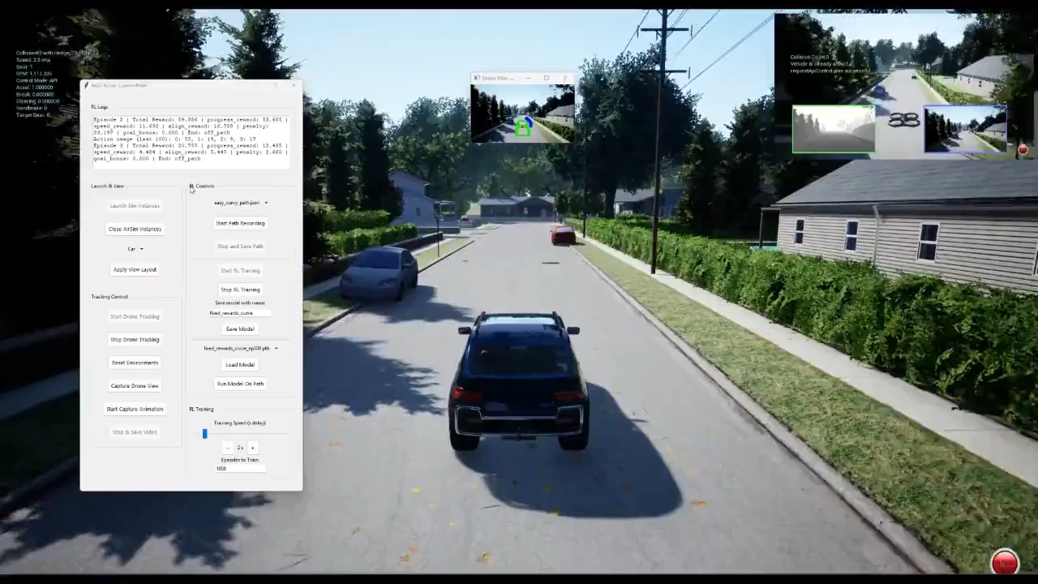
Future Research

Slide 9
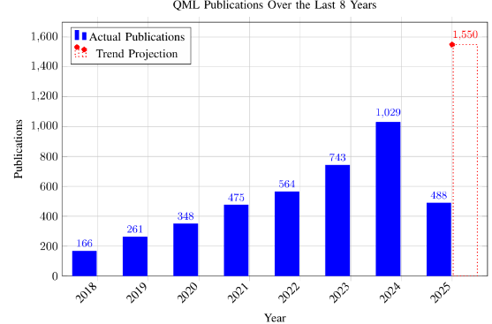
What’s Next for HQNNs?
Circuit cutting and optimization
Application expansion
Hardware progress

Slide 10


Responsible Quantum AI: A Critical Priority
HQNNs entering sensitive fields
Need for accuracy and interpretability
Quantum Creates greater abstraction
Research should aim towards this goal

Slide 11
Final Thoughts
HQNNs offer meaningful advantages
Best suited for small-data, domain specific applications
Accuracy, Transparency, and Interpretability
A step towards fully quantum AI
Key challenges remain for real-world adoption

Slide 12

Thank you!

